Slide 1

SafeStroll
Streamlining School Active Travel Planning in the City of Vancouver
September 9, 2018
Notes:
While fatalities and serious injuries are on the decline in Vancouver, they continue to occur in our network. We all came here this weekend to work toward the city’s goal of zero traffic related fatalities by 2040, because we all know that even one tragic incident is too many.

Slide 2
Fatalities and serious injuries continue to occur in the transportation network, and even one is too many.

Slide 3
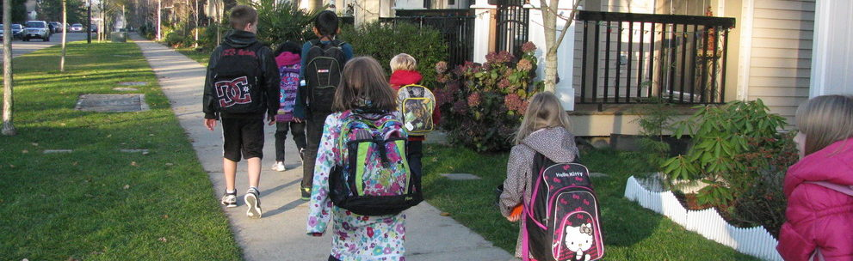
Photo Reference: HASTe BC (hastebc.org)

Slide 4




29,000
STUDENTS
180
SCHOOL DAYS
2
TRIPS PER DAY
5.2
MILLION OPPORTUNITIES
All icons from flaticon.com

Slide 5
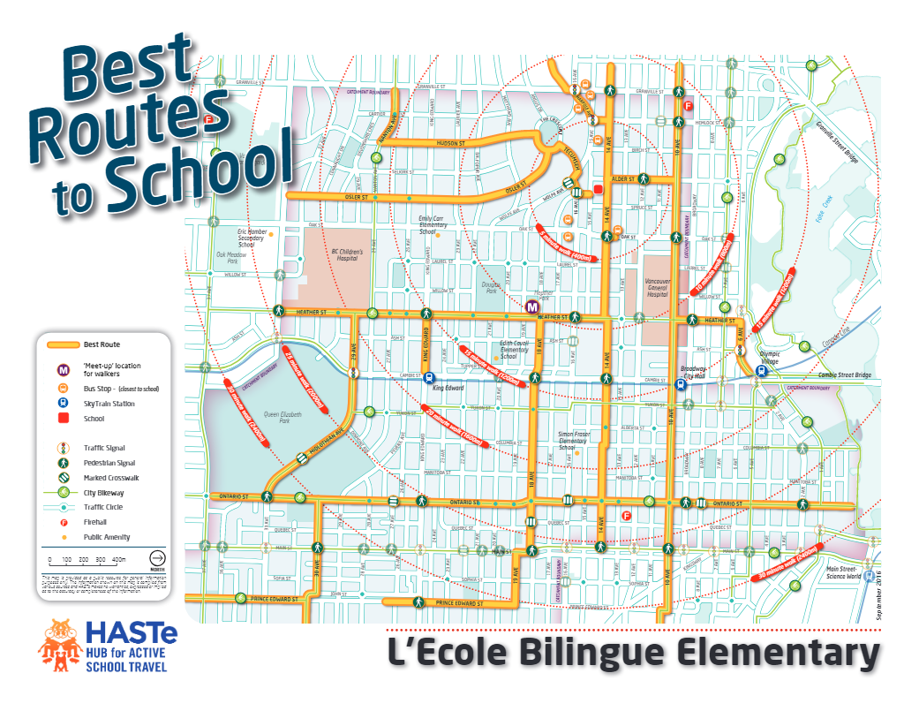

Slide 6
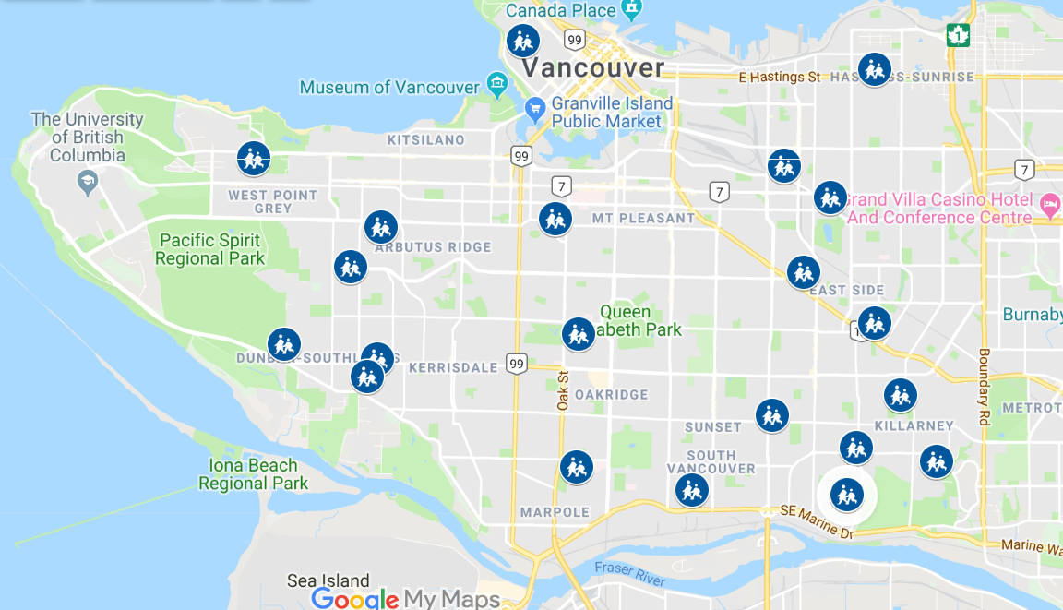
Notes:
Since 2012, city staff have been working hard with schools and communities to identify transportation challenges and opportunities, with the aim of:
Improving walking and cycling infrastructure around schools, and
Increasing education and awareness around active transportation
During this time, action plans and best walking and cycling route maps have been developed for schools that have participated in the School Active Travel Planning program. Each year, current resources allow four or five schools to participate in the program.

Slide 7
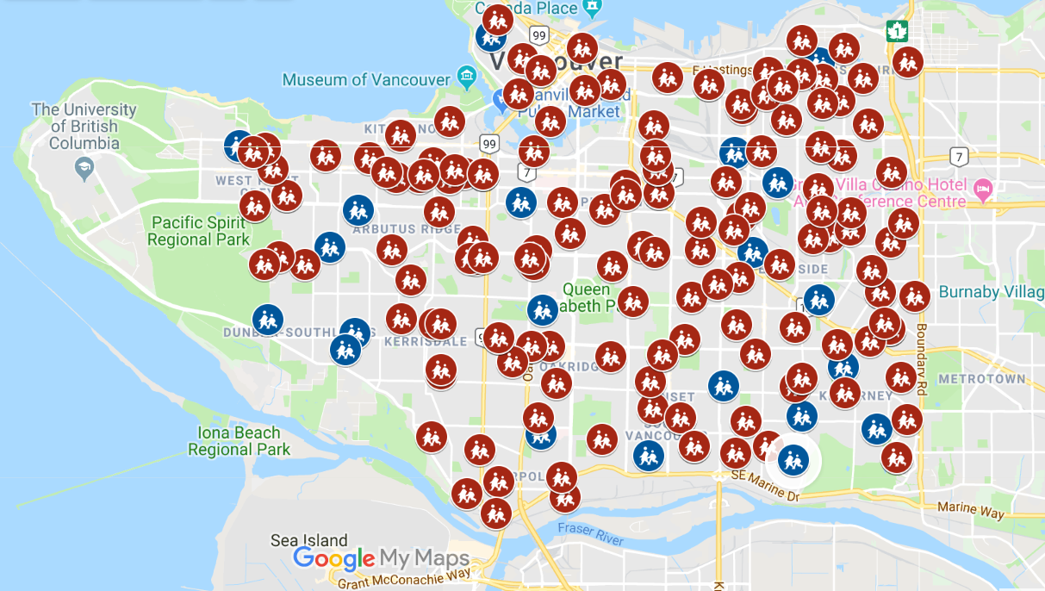
Mott MacDonald | SafeStroll Presentation

Slide 8
What if we could streamline this process?
Notes:
But what if there was a way to streamline this process?
And what if parents had the best possible information to get their kids to school safely
At their fingertips
And updated in real time?
What if we could go from planning for 4 schools a year
To every school this year?

Slide 9
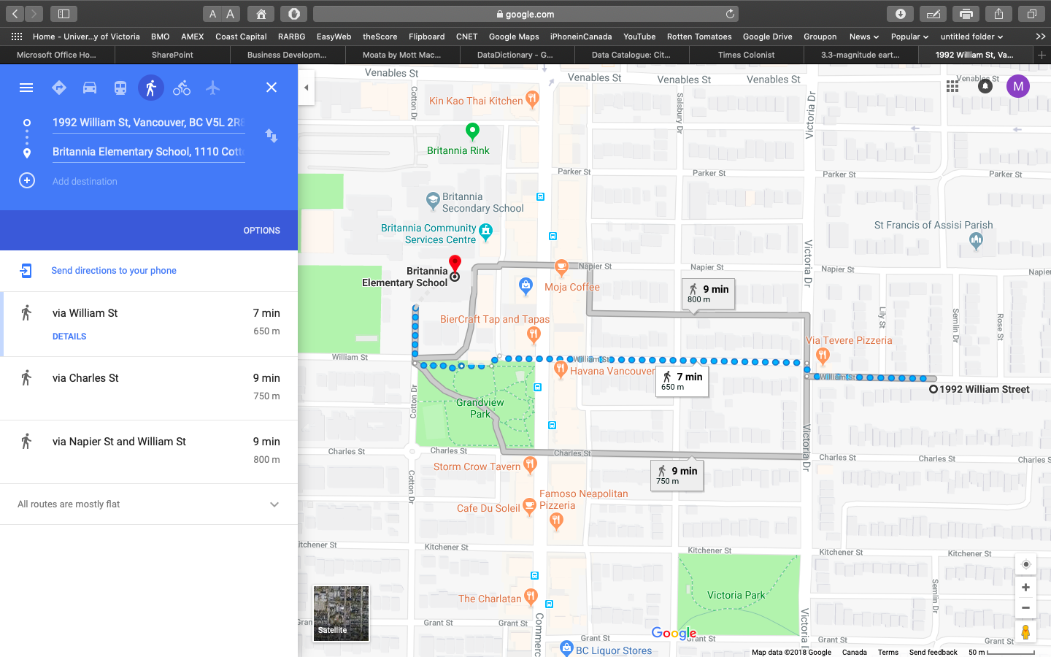
Notes:
Britannia GOOGLE MAPS ROUTES

Slide 10
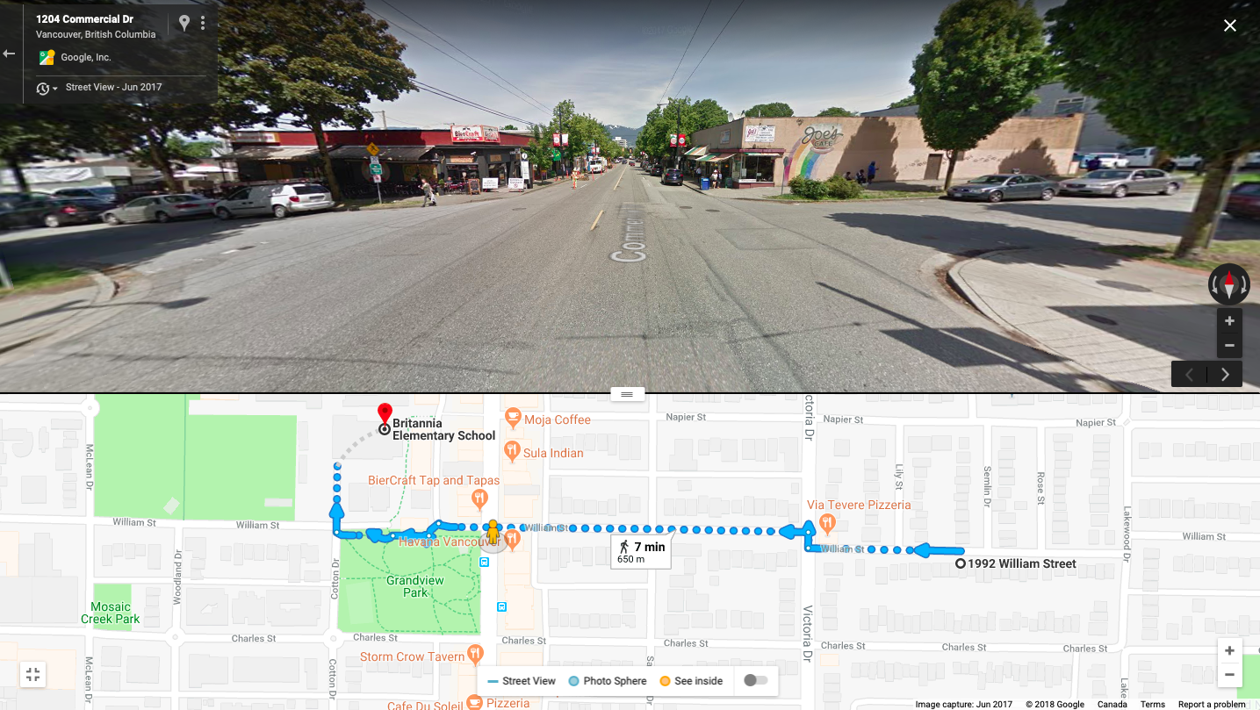
Notes:
Britannia GOOGLE MAPS CHOSEN ROUTE

Slide 11
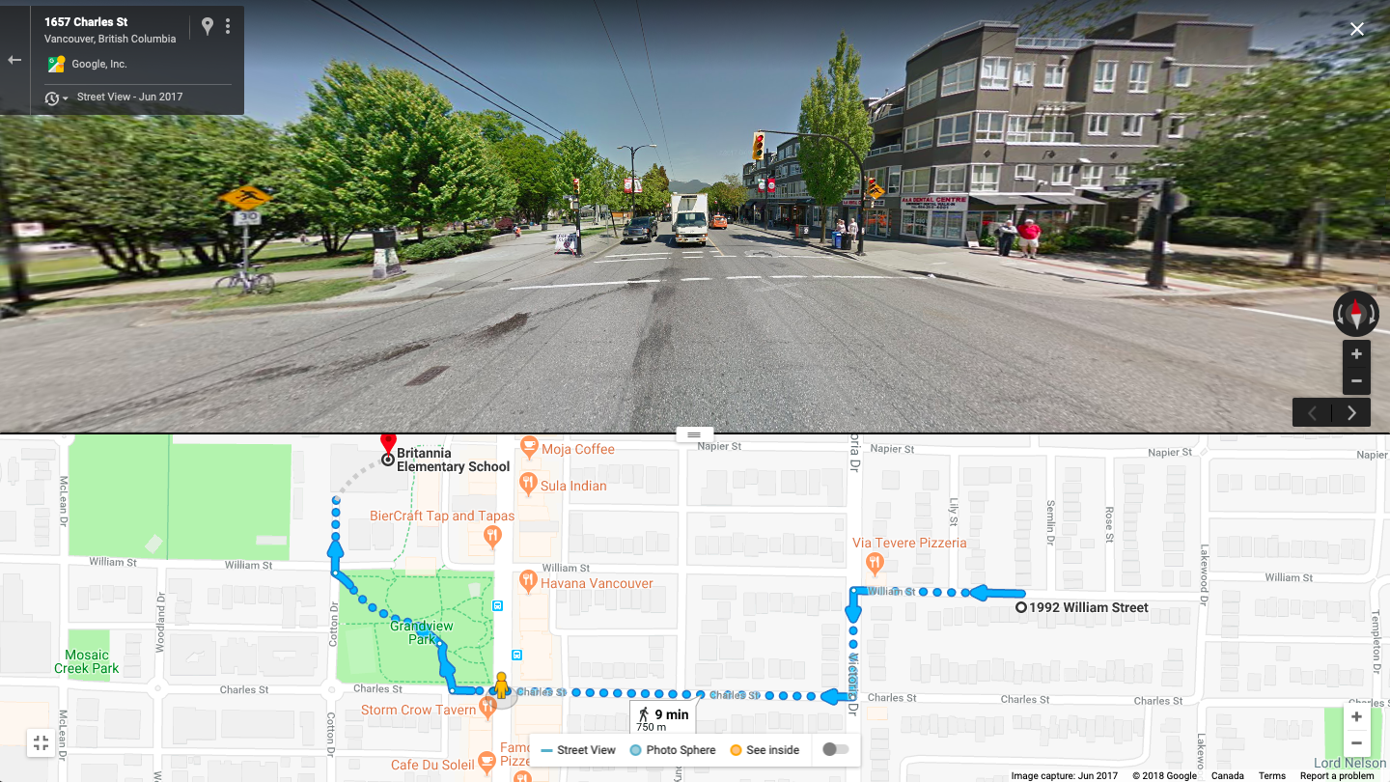
Notes:
Britannia - SafeStroll Route

Slide 12
Notes:
GIF

Slide 13
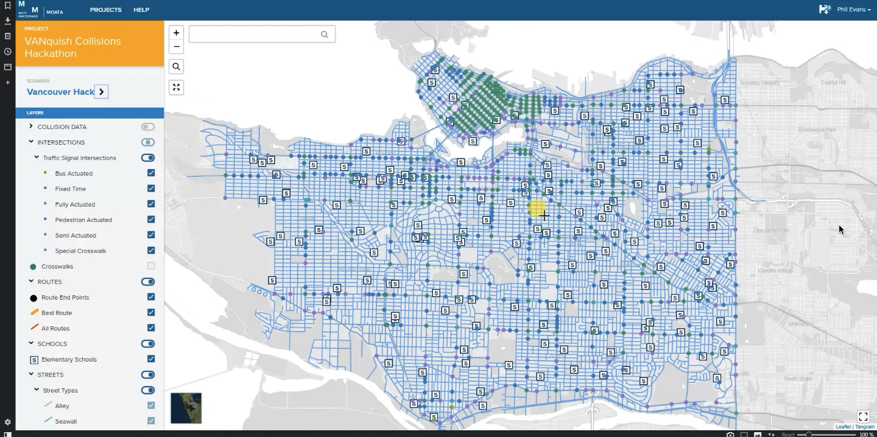

Slide 14
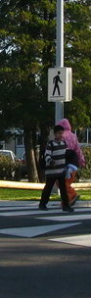

Additional Features
Capacity for Community Engagement + Data Sourcing
1
Integration with VanConnect
5
Linkage to asset management system
3
Platform for networking + collaboration
7
Kids Being Kids!
2
Crowd-sourced Hazard Reporting
6
Active transportation log + incentives
4
Alerts and safety tips for education
8
Safe routes to parks and community amenities

Slide 15
SafeStroll
Improving outcomes for all
1
2
3
Parents Education Networking Decision-making Comfort + assurance
Children Engage + socialize Learning Kids being kids! User-friendly
City Staff, Decision-Makers Streamlined planning Prioritized improvements Crowd-sourced data
With SafeStroll, parents, children and the City can work together to improve safety. And fast.

Slide 16
SafeStroll: The big picture
For City Engineers + Planners, Parents, Students, and General Public
1
INNOVATION
Efficient development of School Active Travel Planning programs
Integrated parameters + factors in one to broaden smart transport choices
2
FEASIBILITY
A one time investment to streamline School Active Travel School Planning
Consolidate existing data
Improve results
3
USER EXPERIENCE
Intuitive interface
Real-time reporting
Personalized transport choices
4
STRATEGIC THINKING
Insight into long-term trends and patterns
Ability to isolate issues and target action
Complement predictive modelling and scenario planning
Smarter decision-making
5
ALIGNMENT WITH CHALLENGE
A clear focus on safety
Supports our most vulnerable population
Working toward zero
Notes:
1 How unique is the solution?
2 How easily can the solution be implemented?
3 What is the overall experience of a person using the product?
4 Is the solution scalable? Will it continue to be relevant for the foreseeable future?
5 Did the solution clearly identify the problem they are attempting to solve? Is the solution relevant to the identified challenge?

Slide 18
SafeStroll: Proposed Solution
Front-end Process Overview
Pick your home and your school from the map
Generate a trial selection of possible routes
Use a common routefinding API like Google Maps
Apply simple decision analytic to identify the safest routes to school from the trial selection
Present the user with a selection of the best options (i.e. the highest-scoring routes)
e.g. look for crosswalks and controlled intersections where trial routes cross major roads and apply scoring
Offer supplementary insight into potential hazards along the way

